Slide 1


HOME
ABOUT
CONTENT
OTHERS
Page 01
FITNESS APP

Slide 2
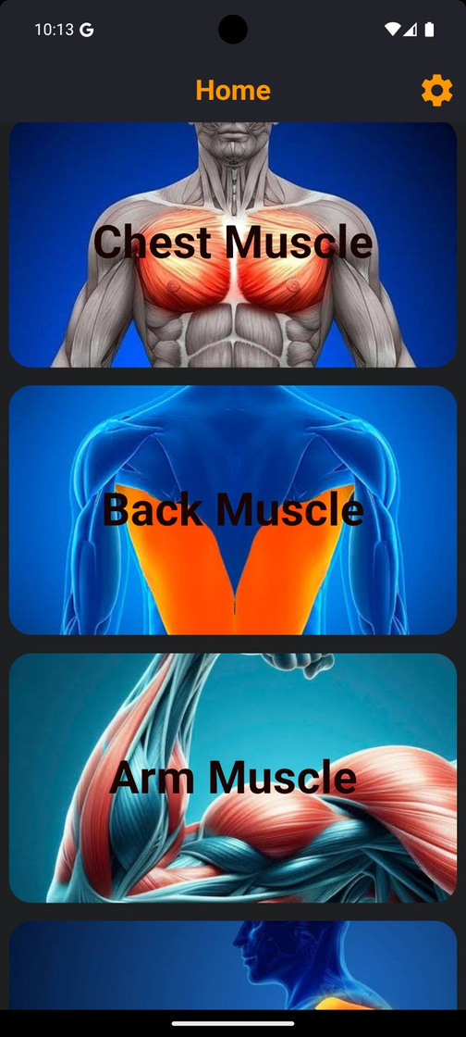
HOME
ABOUT
CONTENT
OTHERS
Page 02
INTRODUCTION
Project Title: Fitness App – Powered by Flutter & Firebase
Purpose:
This app is designed to help users track their fitness activities, set workout goals, and monitor progress in real time.
The goal is to provide an easy-to-use solution that motivates individuals to stay consistent with their fitness routines.
Technologies Used:
Frontend: Flutter for a cross-platform, smooth, and responsive UI.
Backend: Firebase for real-time database, authentication, and storage services.
Target Audience:
Fitness enthusiasts, beginners, and anyone looking to adopt a healthier lifestyle.
Users who need personalized workout plans and simple progress tracking in one place.
Objective of the Presentation:
Walk through the features, architecture, challenges, and future scope of the app.
Showcase how the app stands out by leveraging real-time capabilities using Firebase.
FITNESS APP

Slide 3
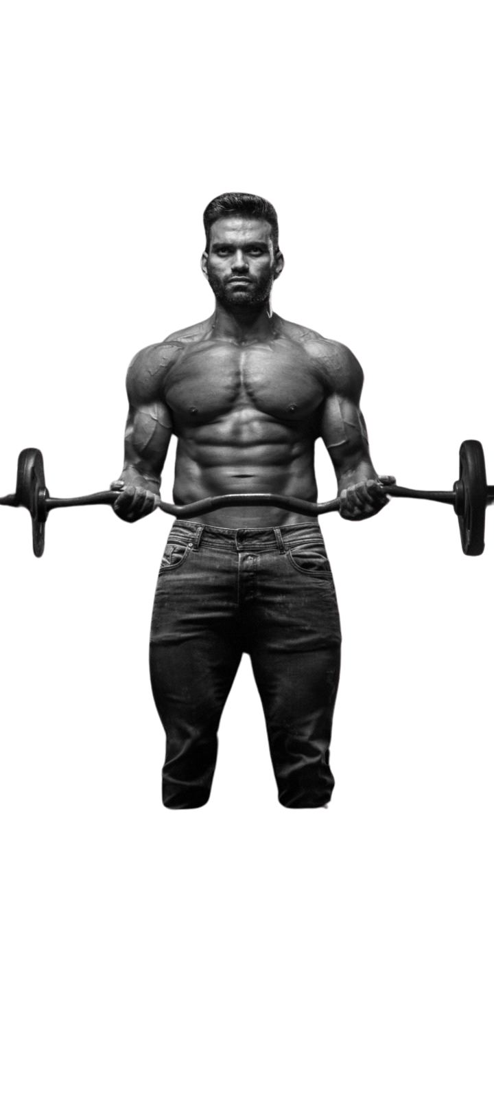

HOME
ABOUT
CONTENT
OTHERS
Page 03
market overview
The global fitness app market is projected to reach $20 billion by 2030, with a CAGR of 21-25% from 2024-2030, driven by rising health awareness and digital fitness solutions. Key trends include a post-pandemic boom in digital workouts, increased integration with wearables, and demand for personalized, AI-driven workout plans. Opportunities lie in mobile-first, cross-platform apps, particularly using Flutter, and enhanced features like real-time data sync via Firebase. Additionally, the focus on wellness creates space for apps combining fitness with mental health and wellness features.

Slide 4
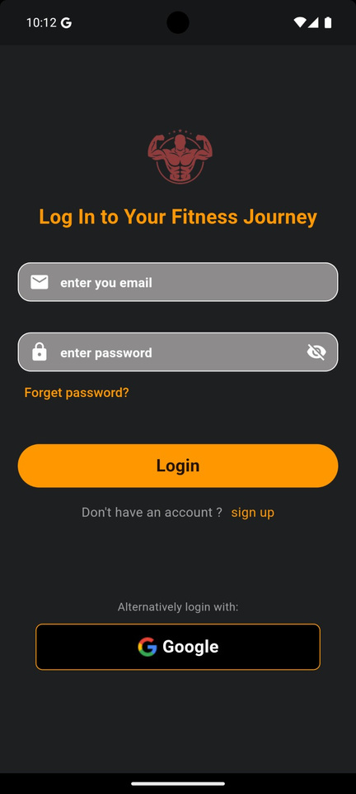
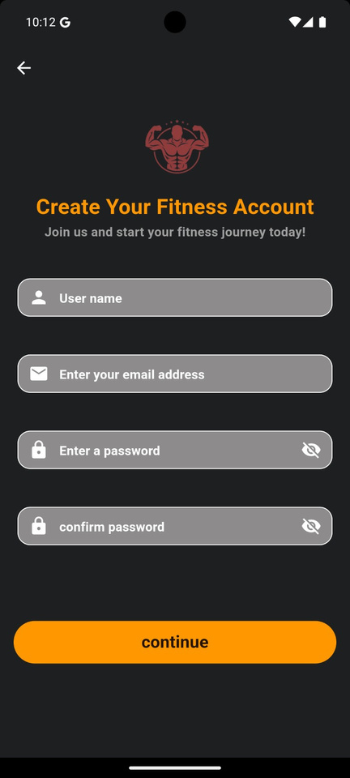
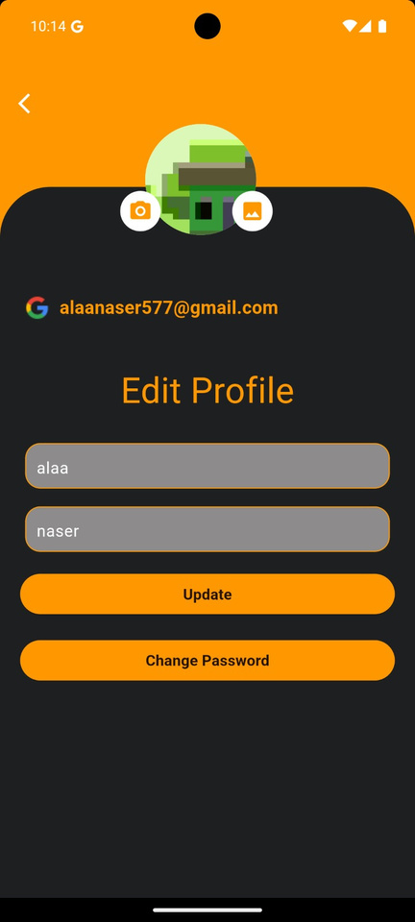
key features
USER AUTHENTICATION
PROFILE MANAGEMENT
WORKOUT BROWSING
SEARCH FUNCTIONALITY
CLEAR EXERCISE INSTRUCTIONS
USER FEEDBACK SYSTEM
RESPONSIVE DESIGN
PERFORMANCE AND RELIABILITY
INTUITIVE NAVIGATION
Page 04

Slide 5
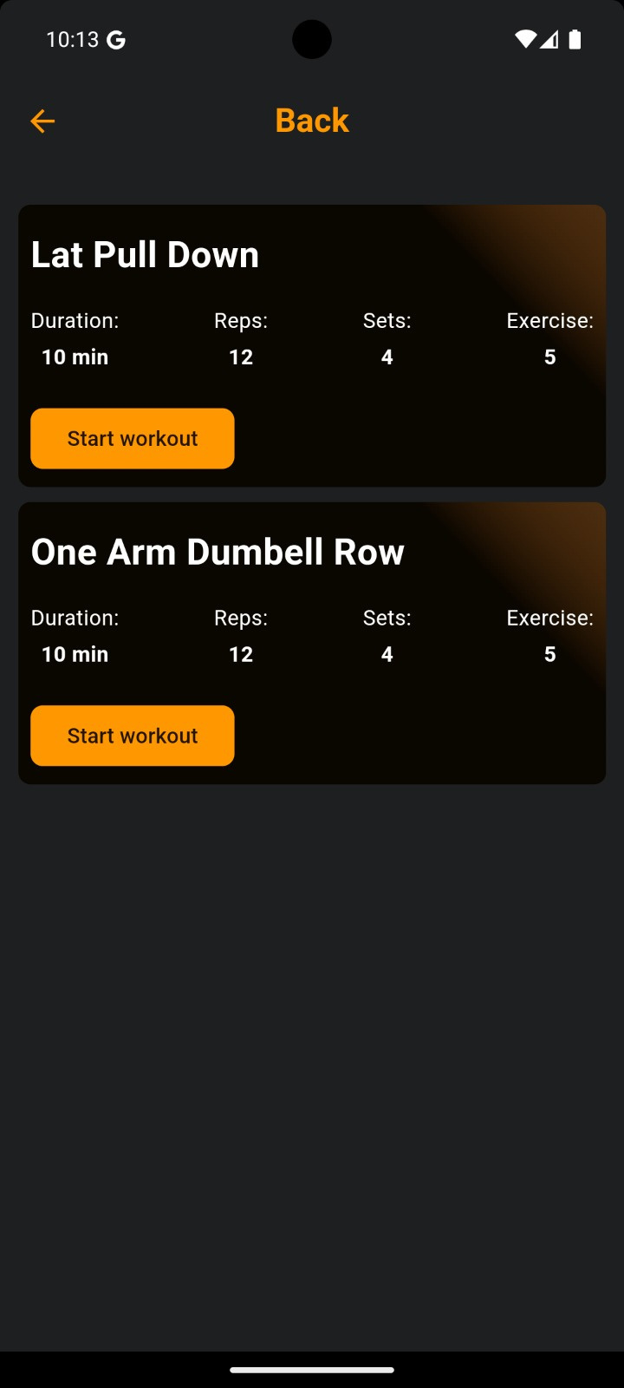
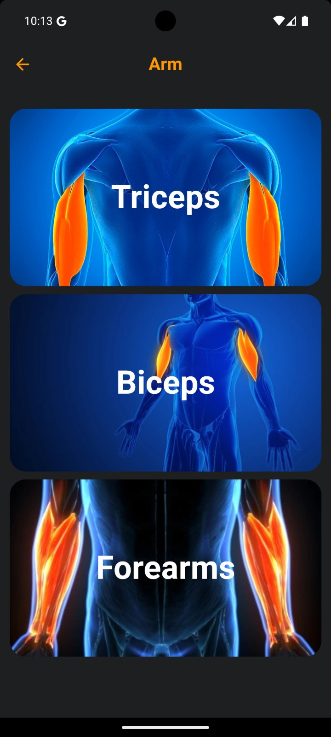
HOME
ABOUT
CONTENT
OTHERS
Page 05
Users benefit from personalized workout plans tailored to their fitness goals and preferences, along with real-time progress tracking through a dedicated profile. Quick and secure login via Firebase Authentication ensures seamless access, while cross-platform functionality (built with Flutter) provides a consistent experience on both Android and iOS, with data safely synced via Firebase. The app's engaging UI and user-friendly design keep users engaged, and future premium options may include additional features for an enhanced experience.
user benfites

Slide 6

HOME
ABOUT
CONTENT
OTHERS
Page 06
COMPALICITY
1
AVAILABLE FOR BOTH IOS AND ANDROID
devices, making it accessible to a wide
1 range of users.
2
OPTIMIZED FOR TABLET USE, PROVIDING A
larger display for enhanced
CONTINUOUS UPDATES ENSURE COMPATIBILITY
with the latest operating systems and
devices, providing users with the best
experience.
3

Slide 7

HOME
ABOUT
CONTENT
OTHERS
Page 07
FUTURE DEVELOPMENTS
our fitness app is very powerful but in future we seek to connect it with ai tool to predict the best plan for user to achieve its target quick
also we need to add more excerises to be helpful for the users

Slide 8
HOME
ABOUT
CONTENT
OTHERS
Page 08
THANK YOU

